Slide 1
Multicollinearity for feature selection (using Auto MPG)

Slide 2
Technique to identify threshold
There is no foundation for stating whether this value is better than 5 or 10 because there is no formal method for stating when the correlation among effects is too large. (Craney and Surles, p.394) [1]
The technique requires that the VIFs for each effect be calculated in the usual manner by fitting the full model with all effects. Then, a stepwise routine is implemented to remove variables causing loss of precision in parameter estimates by starting with the variable having the largest VIF. (Craney and Surles, p.394) [1]

Slide 3
VIF threshold (references)
R2_score >= 0.8, highly correlated (VIF >= 5) [1] page 147.
VIF >= 5 or 10 indicate problematic amount of collinearity [2] page 101.
VIF >= 2.5 considerable collinearity [3].
VIF >= 10 means collinearity [4]

Slide 4
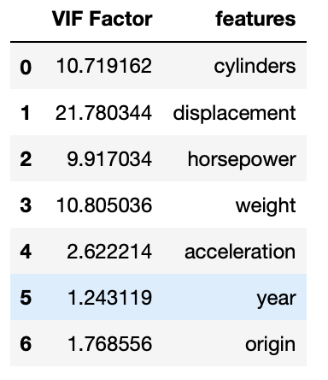
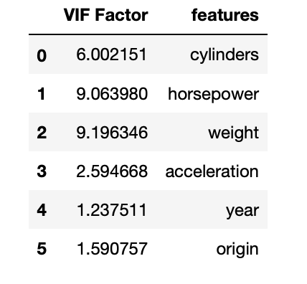
VIF of Auto MPG parameters

Slide 5
Linear Model Tree (updated)
Feature dropped | MSE | MAE | %
Without dropping | 8.61 | 2.04 | Baseline
displacement | 8.878 | 2.098 | 3.11
cylinders | 8.828 | 2.089 | 2.53
weight | 8.913 | 2.060 | 3.52
horsepower | 8.5272 | 2.0001 | -0.96
acceleration | 8.4212 | 2.085 | -2.19
year | 14.381 | 2.703 | 67
origin | 8.988 | 2.132 | 4.39

Slide 6
MLP
Feature dropped | MSE | SOC | %
Without dropping | 6.960 | 1214 | Baseline
weight | 7.174 | 1212 | 3.074713
horsepower | 7.286 | 1212 | 4.683908
cylinders | 7.147 | 1212 | 2.686782
displacement | 6.981 | 1212 | 0.301724
acceleration | 7.852 | 1212 | 12.81609
year | 7.748 | 1212 | 11.32184
origin | 7.871 | 1212 | 13.08908

Slide 7
SVR
Feature dropped | MSE | SOC | %
Without dropping | 6.5078 | 8162 | Baseline
horsepower | 6.502 | 7144 | -0.08912
cylinders | 6.3646 | 7220 | -2.20044
displacement | 6.436 | 7201 | -1.10329
weight | 6.7633 | 7125 | 3.926058
acceleration | 6.786 | 7087 | 4.27487
year | 12.310 | 7144 | 89.15763
origin | 6.449 | 7049 | -0.90353

Slide 8
Explanation
Removing highly collinear features does not increase error too much regardless of its correlation with target variable (safe)
Removing non-collinear features may increase error depending on its contribution to target variable (risky)

Slide 9
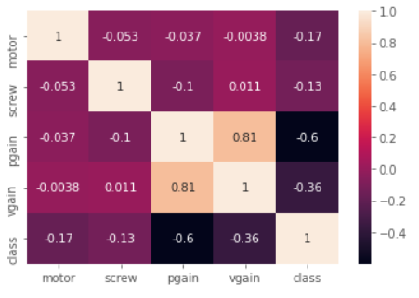
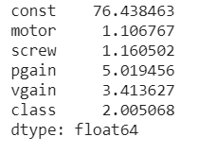
Servo

Slide 10
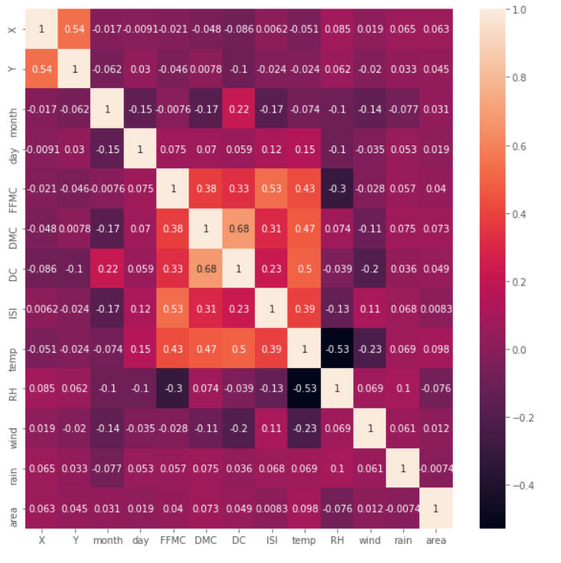
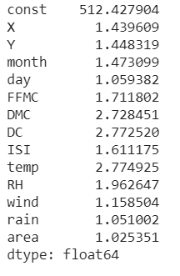
ForestFire

